Slide 1

Live Cricket Score Mobile App
Real-time cricket scores at your fingertips

Slide 2

The Problem: Fans Miss Critical Moments
Current Pain Points
Cluttered interfaces loaded with intrusive ads
Slow load times and delayed score updates
No clean, mobile-first experience exists
Can't track multiple live matches easily
Cricket enthusiasts deserve better — a fast, clean platform that never makes them miss a wicket or boundary.

Slide 3
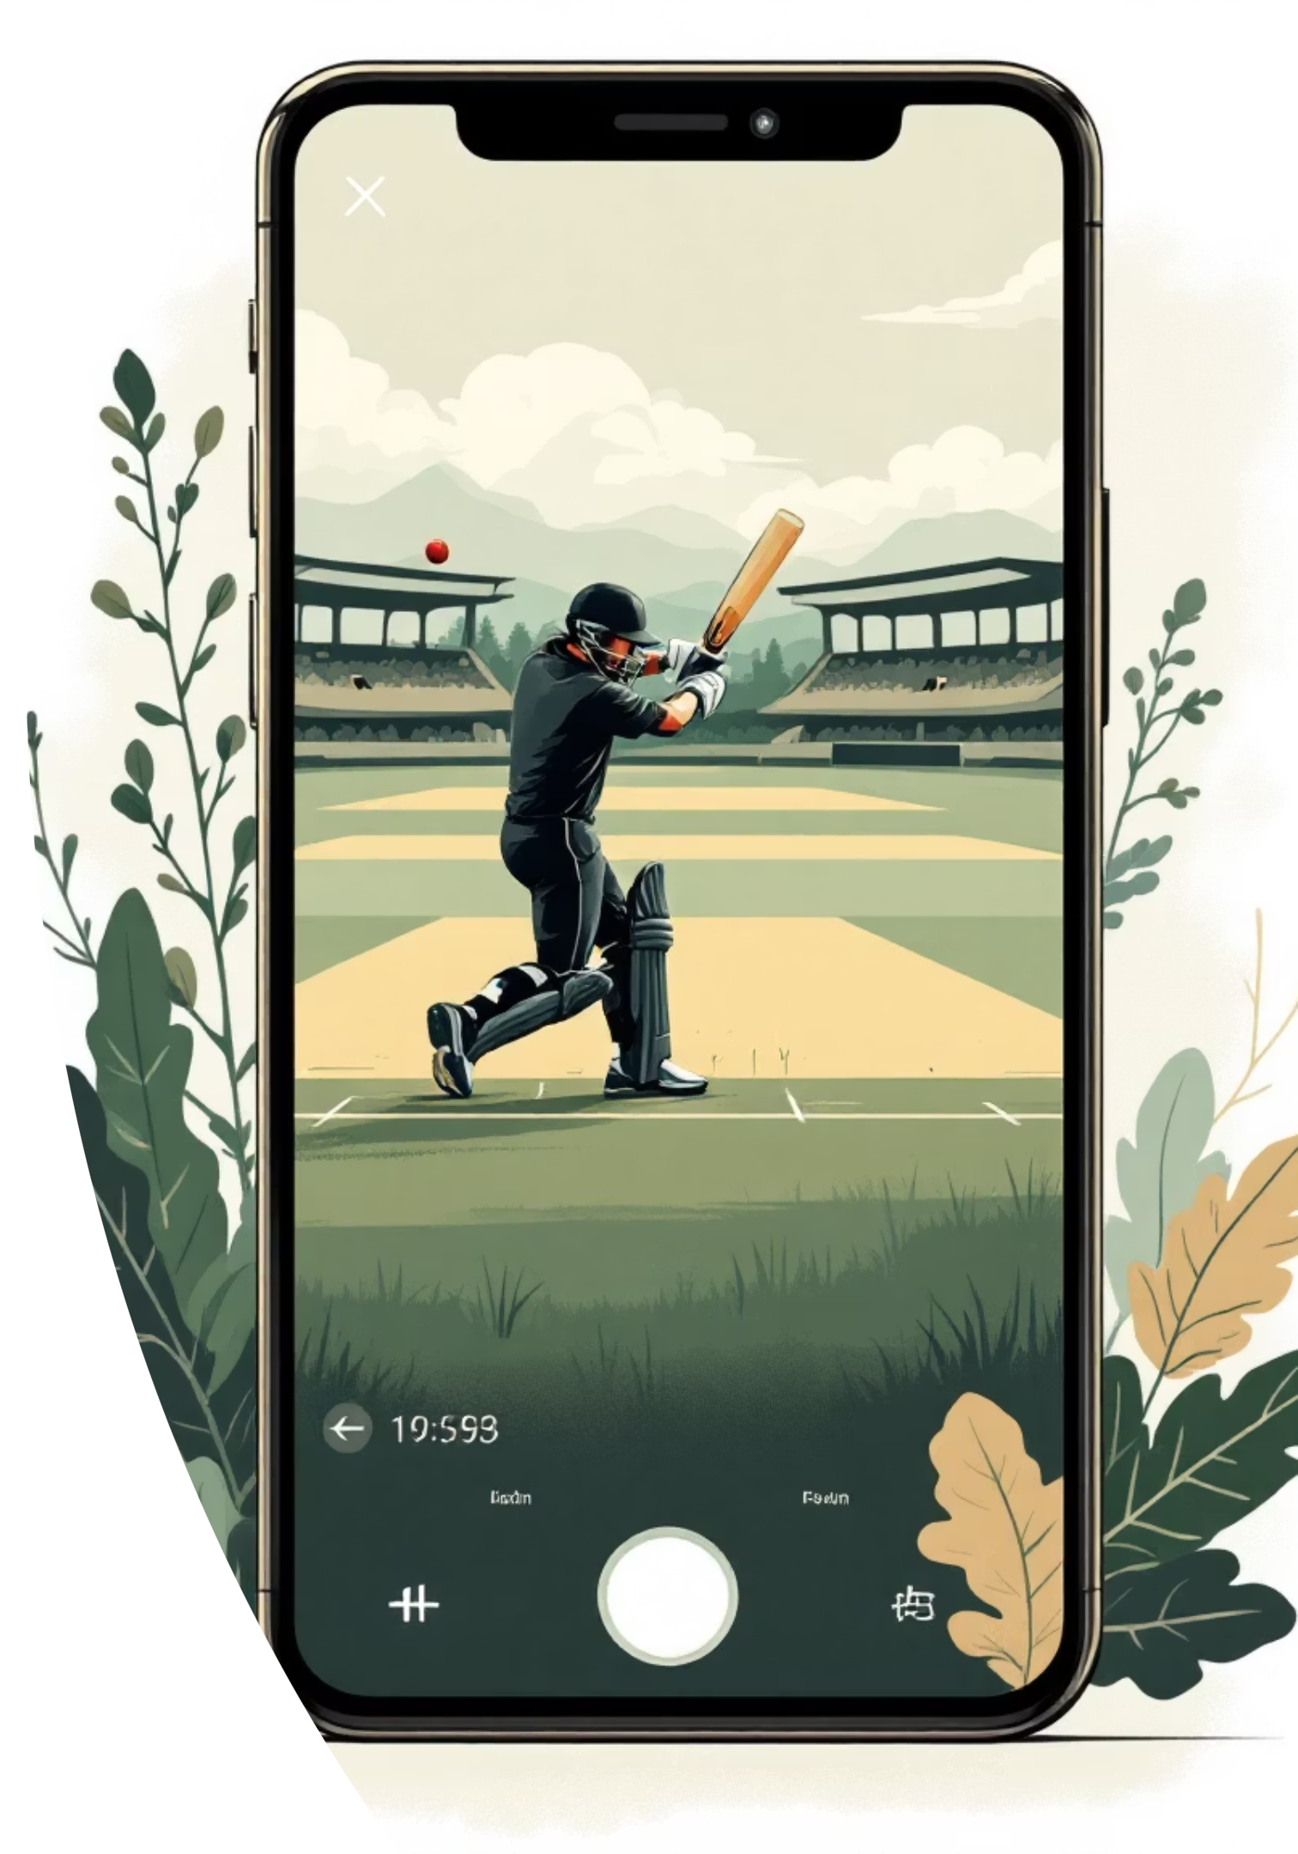
Why This Matters
2.5B
1B+
70%
Cricket Fans
ICC Event Viewers
Mobile-First Users
Worldwide audience hungry for live updates
Massive viewership per major match
Prefer mobile apps for live sports tracking
$5.5B
Market Value
Sports apps market size by 2025

Slide 4


Competitive Landscape: Existing Solutions Fall Short
Cricbuzz
ESPN Cricinfo
Google Sports
Popular but ad-heavy with slow refresh rates
Comprehensive coverage but cluttered UI
Basic features, lacks detailed scorecards
Dream11
Official ICC App
Fantasy-focused, not score-centric design
Limited to ICC events only
Gap Identified: No clean, fast, ad-free, mobile-first solution exists in the market

Slide 5
Our Solution: Cricket Scores Reimagined
Lightning Fast
Beautiful Design
10-second auto-refresh ensures you never miss a ball
Clean Material UI with seamless dark/light themes
Complete Data
Live Commentary
Detailed scorecards covering batting and bowling stats
Ball-by-ball updates keep you in the action
Personalized
Always Available
Favorite teams for customized experience
PWA-ready for offline access anywhere

Slide 6
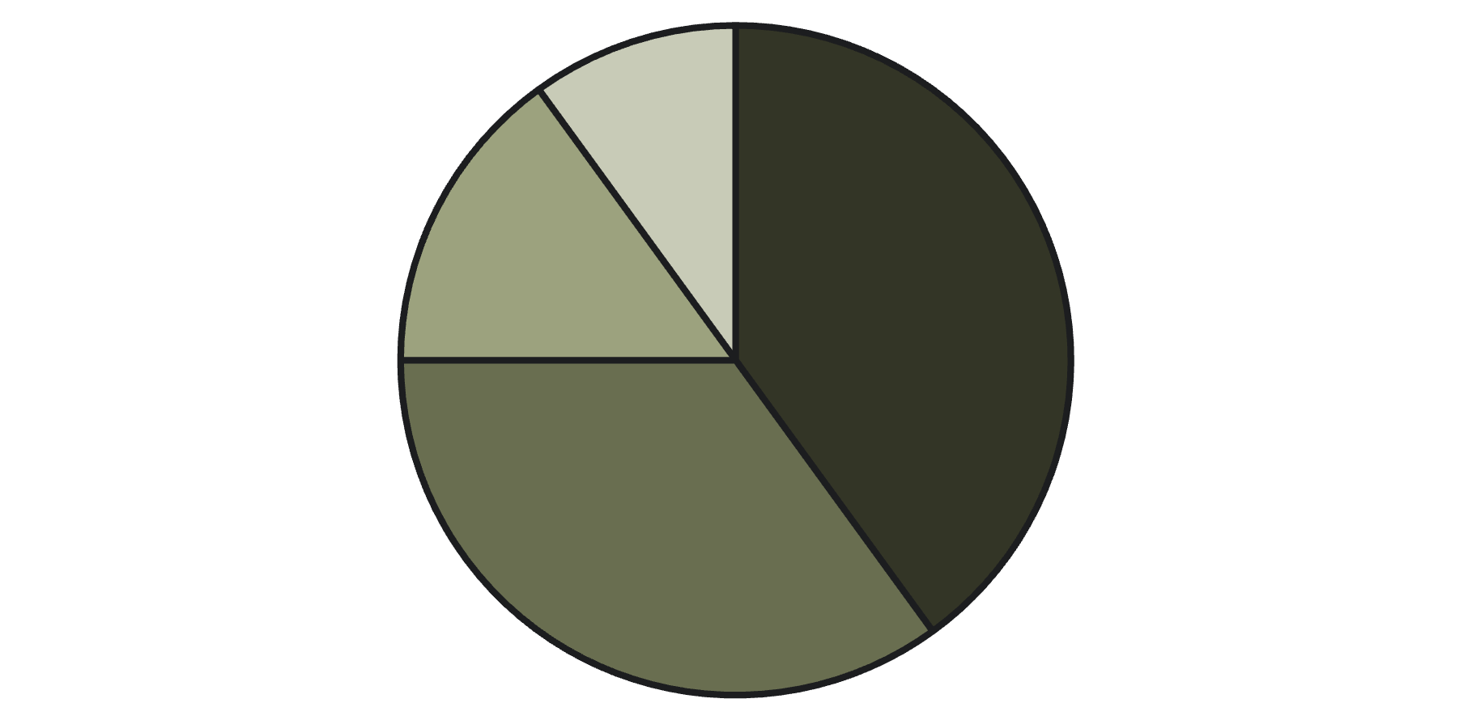
Understanding Our Audience
Key Research Insights
68% prefer mobile apps over websites
Users spend 45 minutes avg. during live matches
62% prefer dark mode for sports apps
Casual Fans
Hardcore Enthusiasts
Fantasy Players
Sports Bettors

Slide 7





System Architecture: Built for Scale
Mobile App Layer
React 18 + TypeScript for robust frontend
REST API Layer
Efficient data fetching and caching
Cricket Data API
Real-time scores, match details, player stats
Supabase Database
User preferences and favorite teams storage

Slide 8
Prototype: Key Screens
Home Dashboard
Match Details
Full Scorecard
Settings Panel
Live, upcoming, and completed match cards with real-time status badges
Live score, run rate, current players, ball-by-ball commentary feed
Complete batting and bowling statistics with innings tabs for deep analysis
Dark mode toggle, favorite teams selection, personalization options
Design Principles: Mobile-first approach, cricket-themed color palette (green/blue), accessibility-focused throughout

Slide 9

Technology Stack: Modern & Reliable
Frontend Power
React 18 + TypeScript
Vite for blazing builds
React Router v6
Design System
Tailwind CSS
shadcn/ui components
Lucide React icons
State & Themes
React Query (TanStack)
next-themes
Dark/Light mode
Backend Ready
Supabase Auth
Database
Cloud Storage

Slide 10

What's Next: The Future of Live Cricket
Achievements ✅
Future Enhancements 🚀
Real-time updates with 10s refresh
Push notifications for wickets
Clean, responsive mobile UI
Live video streaming
Dark/Light theme support
AI match predictions
Comprehensive scorecards
Advanced player analytics
Multi-language support
In-app documentation
Real cricket API integration
Bringing Cricket Fans Closer to the Game

